Slide 1
Tutto quello che bisogna sapere su OAGB Indicazioni Pasquale Mugione Azienda Ospedaliera dei Colli Ospedale Monaldi Napoli UOC Chirurgia Generale

Slide 2
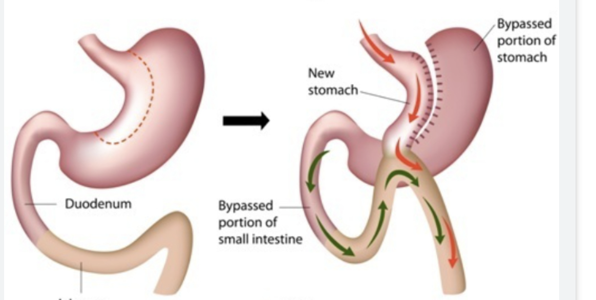
1997:
R.Rutledge
MGB

Slide 3
1997: mini gastric bypass (MGB)
2002: one anastomosis gastric bypass (OAGB)
Single anastomosis gastric bypass (SAGB)
Omega loop gastric bypass (OLGB)
2013: mini gastric bypass-one anastomosis gastric bypass (MGB-OAGB)
2018 IFSO position statement: one anastomosis gastric bypass (OAGB)

Slide 5
OAGB strenghts on RYGBP
Less demanding technical challenges
Shorter operative time
Shorter learning curve
Significant EWL and resolution rate for type II diabetes

Slide 6
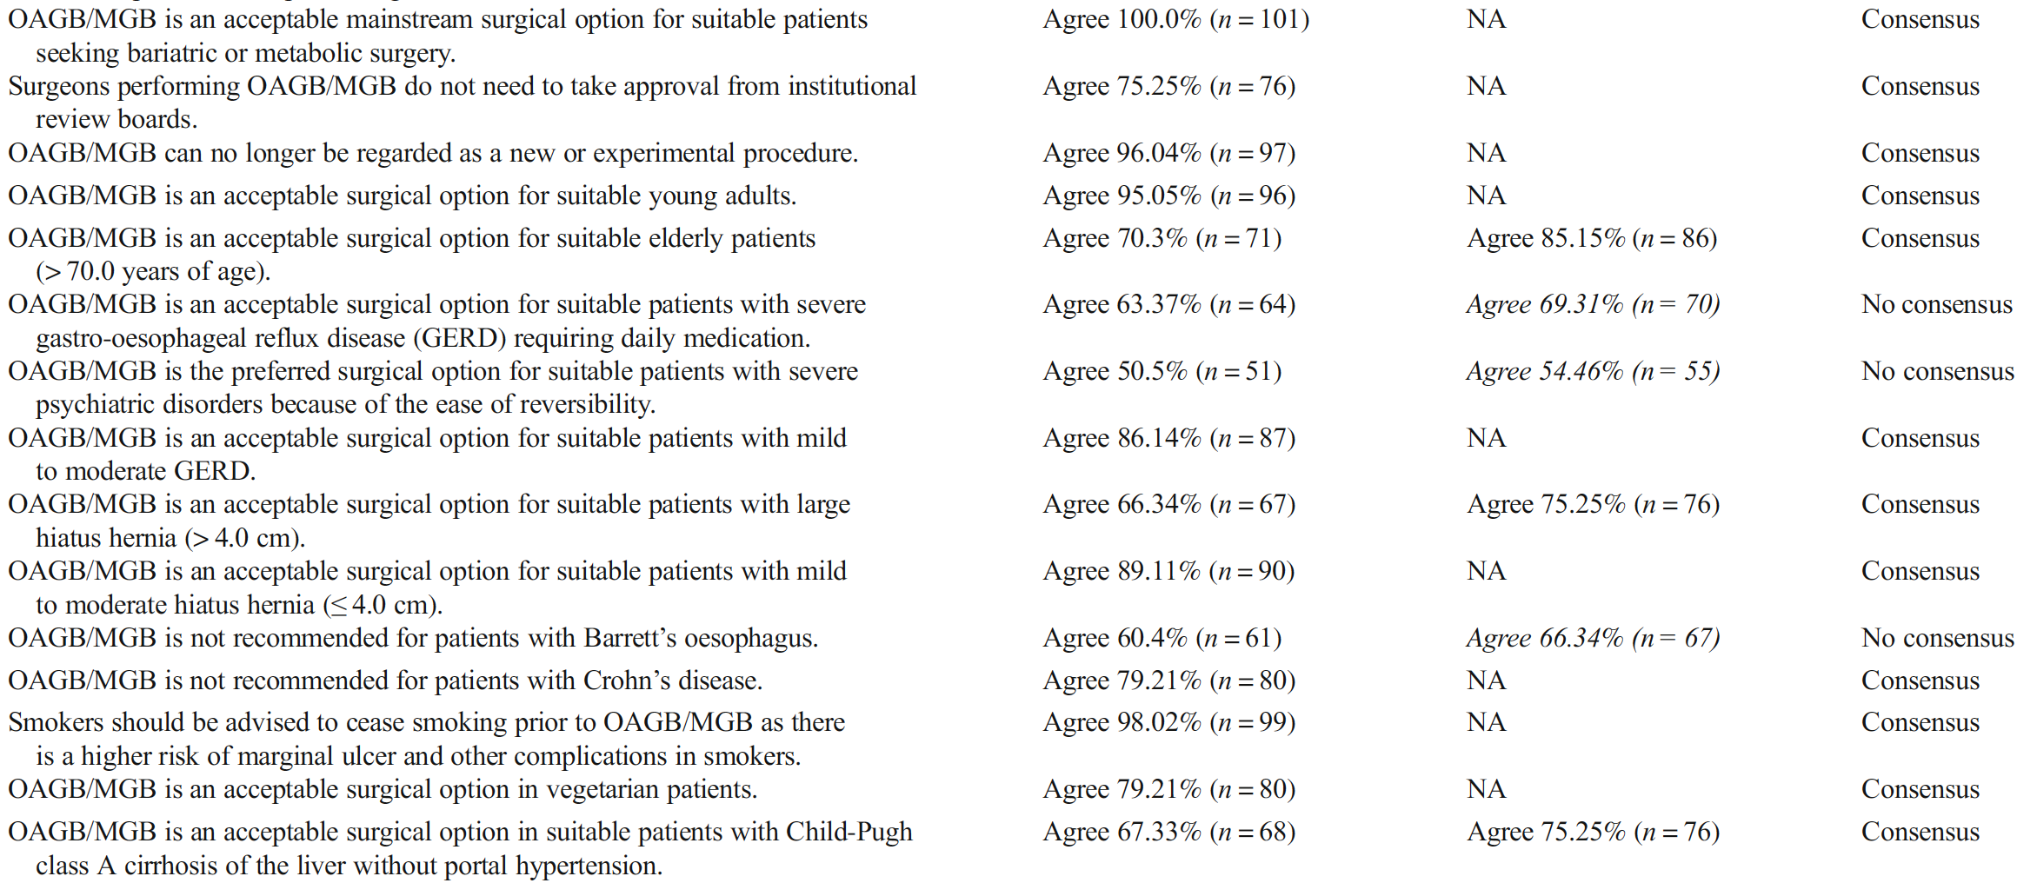

Slide 7
- accetable surgical option for:
suitable young adults
suitable elderly patients
suitable patients with mild to moderate hiatus hernia (<4 cm)
vegetarian patients
Child A cirrhosis of the liver (without portal hypertension)
-smokers have higher risk of marginal ulcer and other complications

Slide 8
No consensus
…for patients with:
severe GERD…
severe psychiatric disorders…
large hiatus hernia
Barret’s oesophagus

Slide 9
- can be recommended for super-obese (BMI>50)/moderate obesity with diabetes
- appropriate procedure for all ages over 24 y
- appropriate revisional option after LSG without severe GERD
- appropriate revisional option after GB
- not recommended for active smokers
- contraindicated for Child C liver disease, Barrett’s esophagus, IBD, grade C esophagitis,

Slide 10
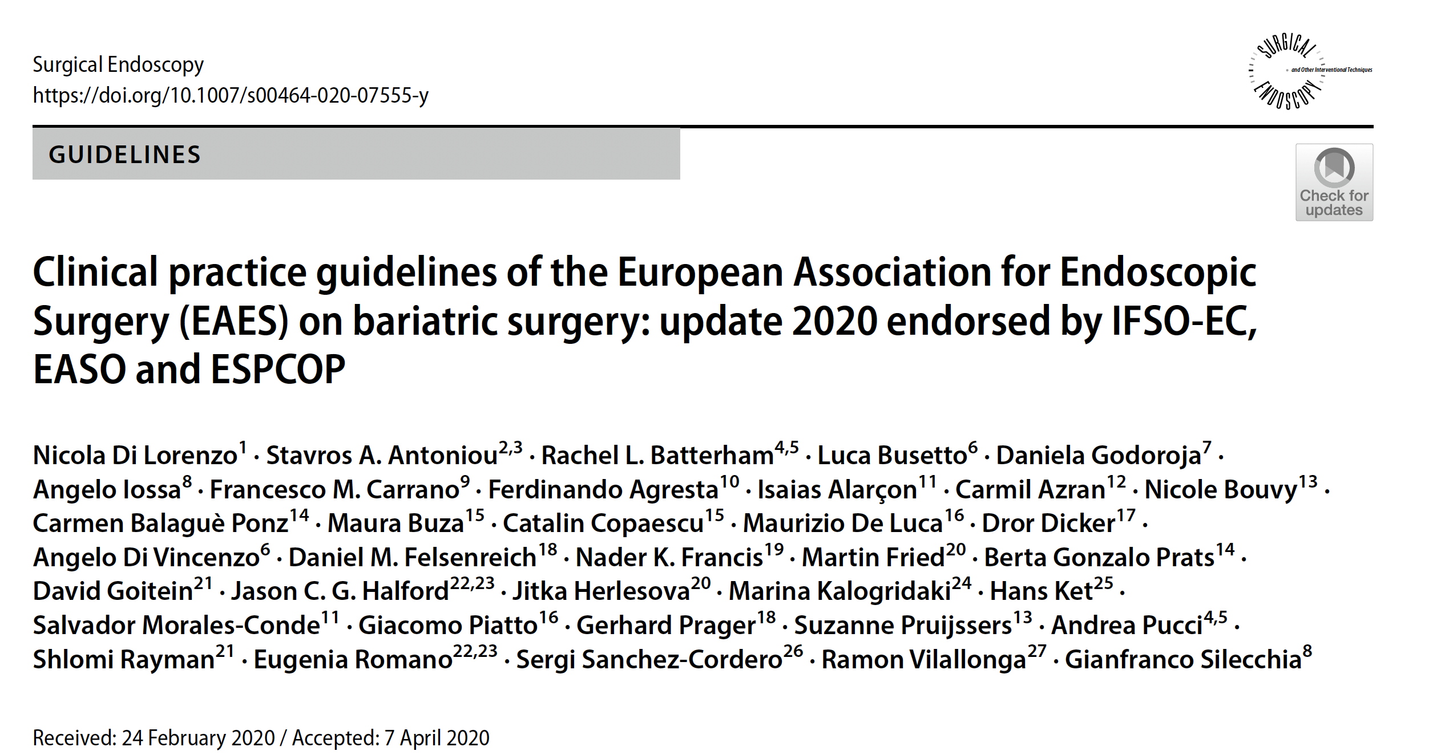

Slide 12
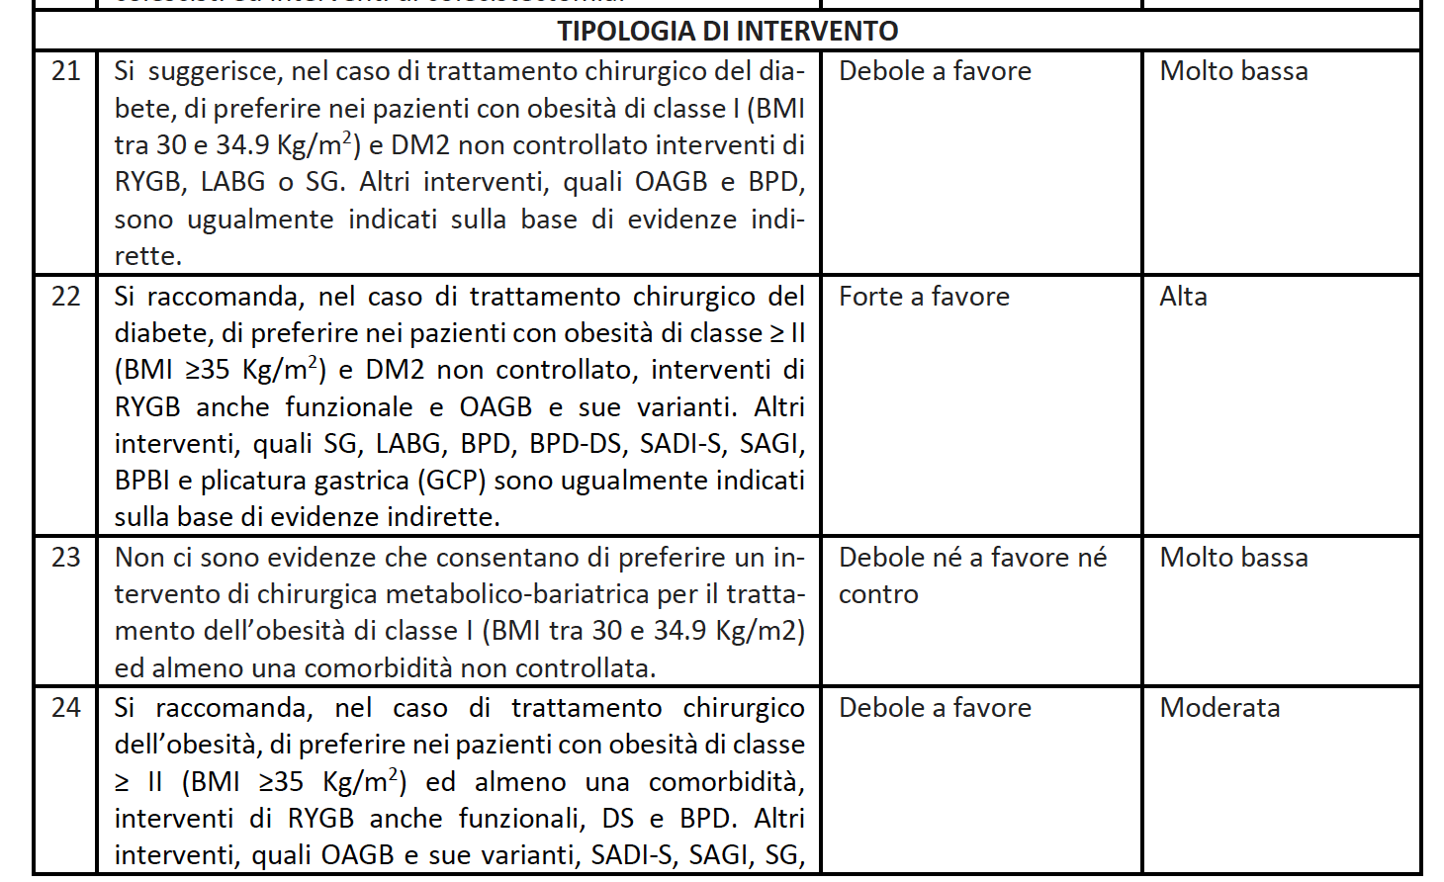

Slide 13
Indications for OAGB
For BMI >35 with diabetes
For ages over 24 y
Redo surgery after LSG (with severe GERD) and after GB
Contraindications
Barrett’s Esophagus
IBD
Severe GERD
Child C liver disease

Slide 14
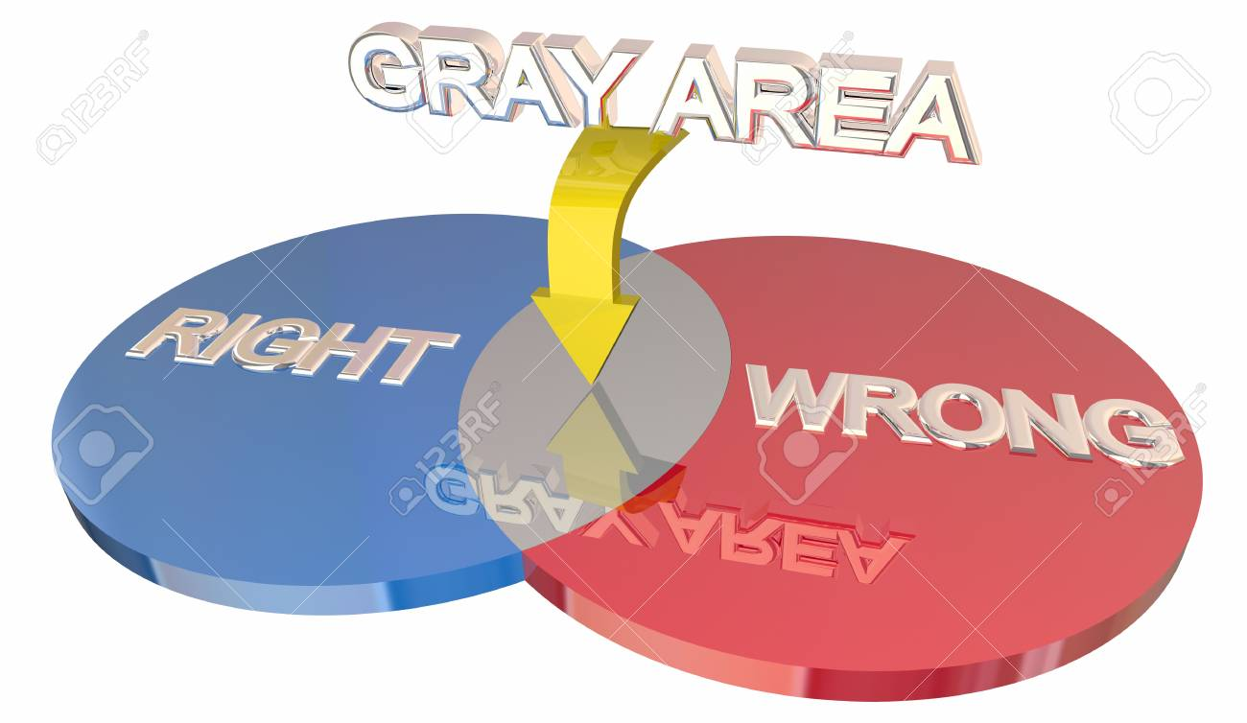

Slide 15
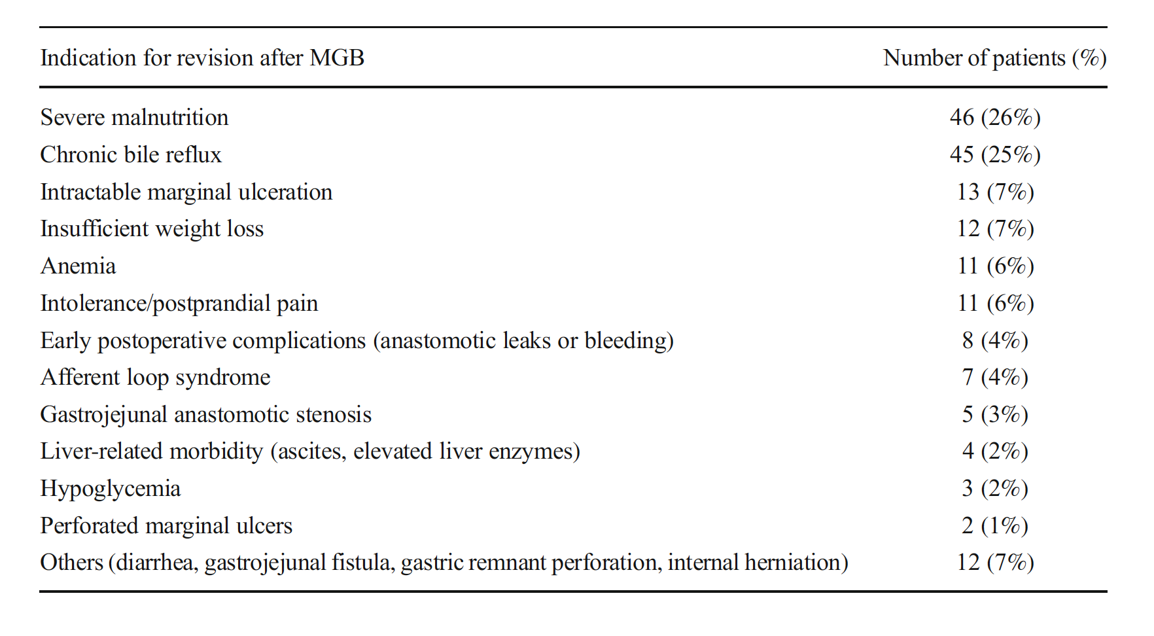

Slide 16
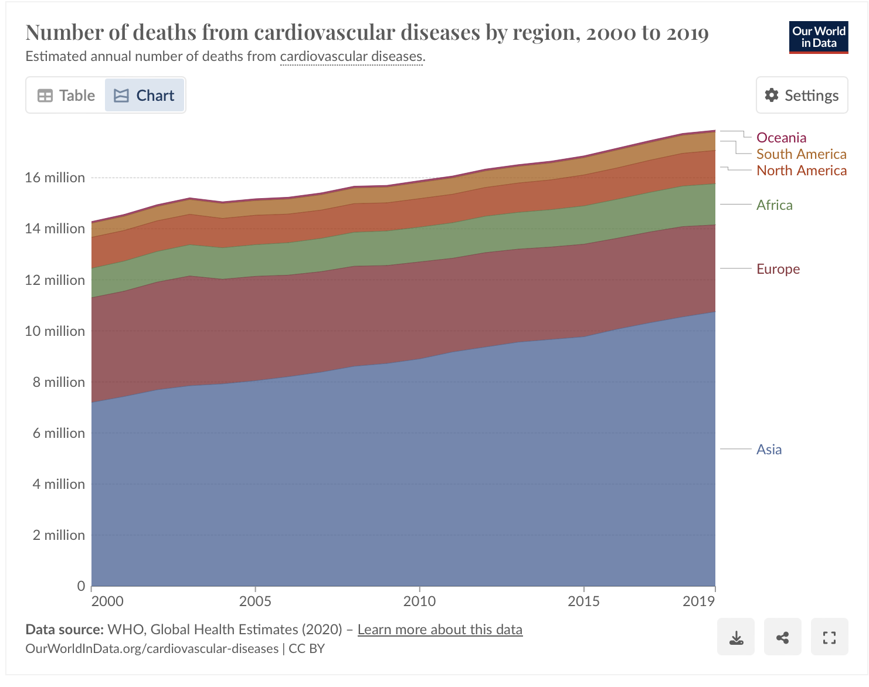
Indications and Gray areas
Appropriate procedure for all ages over 24 y (Ifso Consensus 2020)
…and for future therapy with antiplatelet and asa therapy?

Slide 17
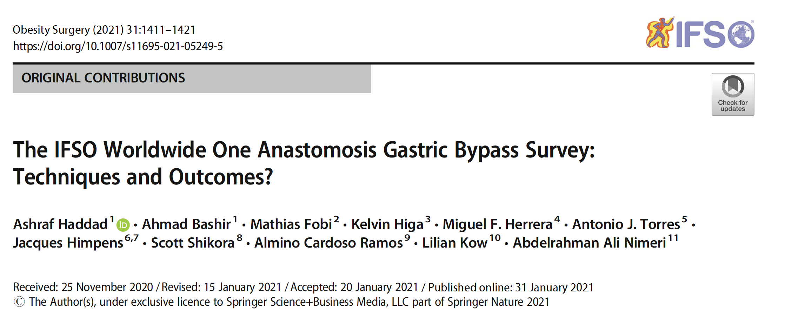
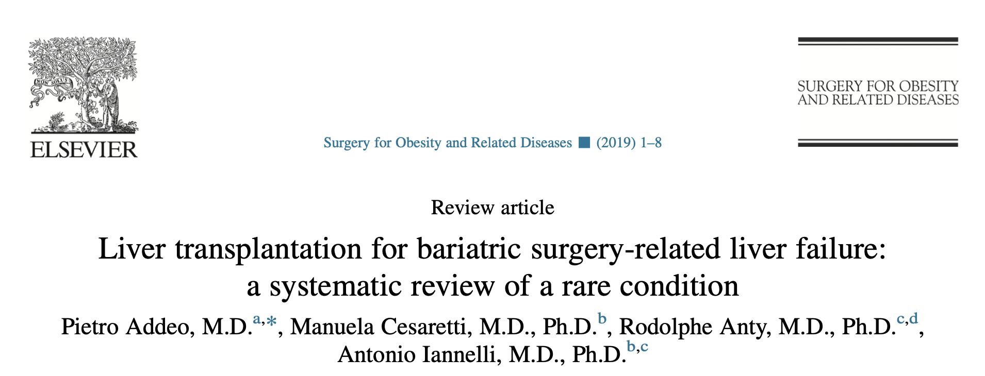
Indications and Gray areas
The effect on nutritional deficiencies are controversial (EAES guidelines 2020)
- controversial lenght of BPL
- liver failure
- nulliparous women?

Slide 18
Indications and Gray areas
Not recommended for active smokers (Ifso Consensus 2020)
…the majority of surgeons (78%) not offer OAGB

Slide 19
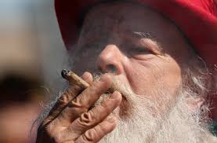
Obese smokers patients…

Slide 20
Grazie

